Slide 1

Implementing Complex Business Logic via Stored Procedures and Functions
Database Management System | SQL and Advanced Query Formulation
Course: Database Management System | Chapter: SQL and Advanced Query Formulation | Program: B.TECH-CSE, B.TECH CSE - CYBER SECURITY, B.TECH CSE - DATA
DISCOVER · LEARN · EMPOWER
Notes:
Welcome everyone to today's session on SQL and Advanced Query Formulation. We are diving deep into how to move complex business logic from application code directly into the database layer. This approach is critical for building robust, scalable enterprise systems. Let us begin by understanding the core outcomes we will achieve today.

Slide 2
Course Outcomes
SLIDE 2 / 14
Course Outcome
CO | BT LEVEL | DESCRIPTION
CO1 | BT2 | Explain database architecture, relational model concepts and formal query language foundations including relational algebra and relational calculus.
CO2 | BT3 | Apply relational algebra, relational calculus and SQL constructs to formulate correct and efficient database queries.
CO3 | BT4 | Analyze functional dependencies and design normalized relational schemas up to 5NF ensuring lossless join and dependency preservation.
CO4 | BT4 | Analyze transaction schedules and concurrency control mechanisms to determine serializability, recoverability and correctness.
CO5 | BT5 | Evaluate storage structures, indexing strategies and query optimization techniques for performance, scalability and reliability.
Chandigarh University
2 / 14
Notes:
Today's lecture directly addresses our first two course outcomes. CO1 requires you to understand the architectural foundations of how databases handle logic. CO2 demands that you apply SQL constructs to write efficient, correct queries that handle complex scenarios. By mastering stored procedures, you bridge the gap between theory and practical application.

Slide 3
Learning Objectives
SLIDE 3 / 14
Learning Outcomes
1
Define stored procedures and functions as encapsulated SQL code blocks.
2
Differentiate between scalar functions and table-valued functions in SQL.
3
Analyze the performance benefits of executing logic within the database server.
4
Construct a stored procedure to handle multi-step transactional business rules.
5
Identify common security and maintenance pitfalls in complex database logic.
Chandigarh University
3 / 14
Notes:
By the end of this lecture, you will be able to define and differentiate between the two main types of database objects. We will analyze why moving logic to the server improves performance and security. You will also learn to construct a real-world procedure and identify the pitfalls that often trip up students.

Slide 4
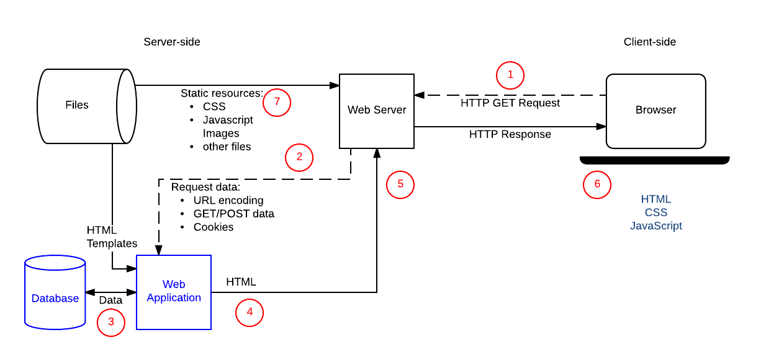
Lecture
SLIDE 4 / 14
Definition of Stored Procedures
1
A stored procedure is a named group of SQL statements saved in the database.
2
It accepts input parameters to customize behavior for different business scenarios.
3
The code executes on the server side, reducing network traffic significantly.
4
It supports complex logic including loops, conditionals, and error handling blocks.
5
Procedures return result sets, output parameters, or status codes to the caller.
Client-server overview - Learn web development | MDN
Chandigarh University
4 / 14
Notes:
Think of a stored procedure as a reusable function that lives inside your database. Unlike a simple query, it can contain loops and complex decision-making logic. For example, a procedure named 'ProcessOrder' can validate stock, deduct inventory, and log the transaction in one atomic call. This reduces the number of round-trips between your application and the database.

Slide 5
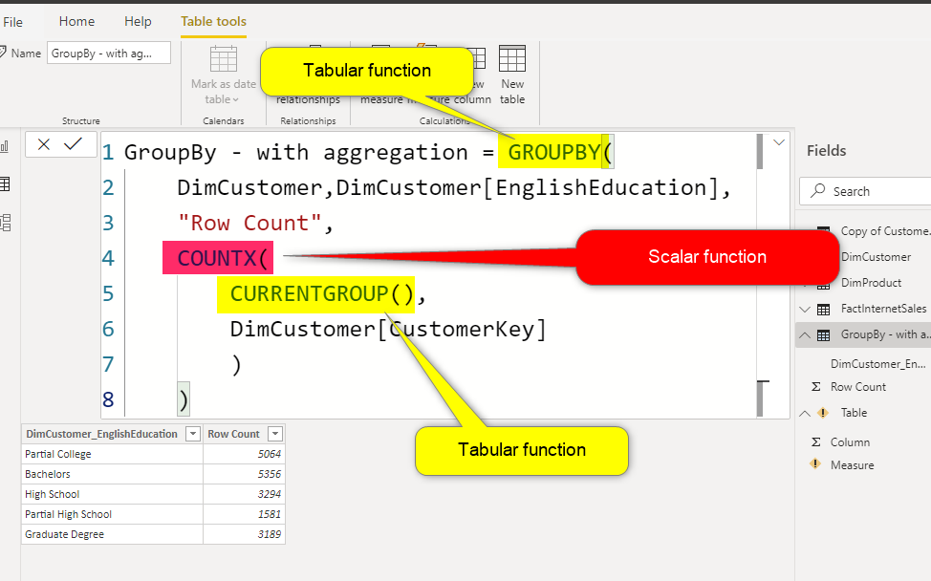
Lecture
SLIDE 5 / 14
Definition of User-Defined Functions
1
A function returns a single scalar value or a table of rows to the query.
2
Scalar functions return one value like a string, number, or date from inputs.
3
Table-valued functions return a result set that can be queried like a table.
4
Functions must be deterministic and cannot modify the database state directly.
5
They are ideal for calculations that need to be used within SELECT statements.
Source: radacad.com
Chandigarh University
5 / 14
Notes:
Functions differ from procedures primarily in their return type and side effects. A scalar function might calculate a discount percentage, while a table-valued function can return a filtered list of products. Crucially, functions cannot change data; they are read-only operations. This makes them perfect for complex calculations within your SQL queries.

Slide 6

Lecture
SLIDE 6 / 14
Business Logic Encapsulation Benefits
1
Encapsulation centralizes rules so changes require updates in one location only.
2
Security is enhanced by granting execute permissions instead of direct table access.
3
Network efficiency improves as only the result is sent back to the client.
4
Data integrity is maintained by enforcing rules at the database layer consistently.
5
Reusability allows multiple applications to share the same validated business logic.
Source: slidemodel.com
Chandigarh University
6 / 14
Notes:
Why do we move logic to the database? Imagine a rule that applies a 10% tax. If this is in five different apps, you must update all five. With a stored procedure, you update the database once. This centralization ensures that every application, whether a web portal or a mobile app, follows the exact same business rules without exception.

Slide 7
Lecture
SLIDE 7 / 14
Syntax Structure of a Procedure
1
The CREATE PROCEDURE statement defines the name and parameter list.
2
The BEGIN...END block encloses the executable SQL logic and control structures.
3
Variables are declared using the DECLARE keyword before use in the block.
4
Control flow uses IF...ELSE for conditions and WHILE for iterative processing.
5
The EXECUTE command calls the procedure with specific argument values.
Chandigarh University
7 / 14
Notes:
Let's look at the syntax. You start with CREATE PROCEDURE followed by the name and parameters. Inside the BEGIN and END blocks, you declare variables and write your logic. For instance, you might declare a variable to hold a calculated total. Finally, you call it using EXECUTE, passing in the necessary arguments to trigger the logic.

Slide 8
Worked Example
SLIDE 8 / 14
Inventory Deduction
GOVERNING EQUATION
Input: ProductID = 101, QuantityToSell = 5
SCENARIO
Deduct stock only if quantity is sufficient and update price.
LOGIC
Check stock >= 5, then UPDATE table, else RAISE ERROR.
CALCULATION
NewStock = CurrentStock - 5; Update timestamp to NOW().
RESULT
Returns success status or specific error code for insufficient stock.
Chandigarh University
8 / 14
Notes:
Consider a scenario where we sell 5 units of product 101. The procedure first checks if the current stock is at least 5. If yes, it subtracts 5 and updates the timestamp. If no, it raises an error immediately. This ensures we never sell more than we have. The calculation NewStock = CurrentStock - 5 happens atomically on the server.

Slide 9
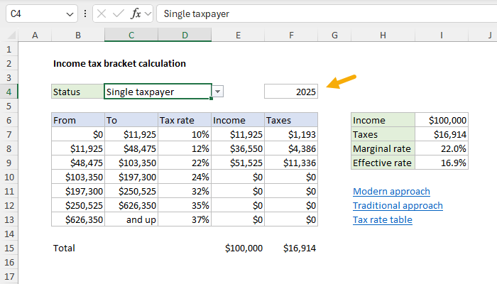
Worked Example
SLIDE 9 / 14
Tax Calculation Function
GOVERNING EQUATION
Input: BasePrice = 1000, Region = 'North'
SCENARIO
Calculate final price with a dynamic tax rate based on region.
LOGIC
IF Region = 'North' THEN rate = 0.12 ELSE rate = 0.08.
CALCULATION
FinalPrice = 1000 × (1 + 0.12) = 1120.
RESULT
Function returns 1120.00 to the calling query.
Source: exceljet.net
Chandigarh University
9 / 14
Notes:
Let's calculate a tax. If the base price is 1000 and the region is North, the rate is 12%. The function calculates 1000 multiplied by 1.12, resulting in 1120. If the region were South, the rate would be 8%, yielding 1080. This function can be embedded directly in a SELECT statement to calculate prices for thousands of rows instantly.

Slide 10
Lecture
SLIDE 10 / 14
Transaction Management in Procedures
1
BEGIN TRANSACTION starts a logical unit of work for the procedure.
2
COMMIT TRANSACTION permanently saves all changes made during the procedure.
3
ROLLBACK TRANSACTION undoes all changes if an error occurs or is caught.
4
Nested transactions ensure data consistency across multiple related table updates.
5
Error handling blocks trap exceptions to prevent partial data corruption.
Chandigarh University
10 / 14
Notes:
Data integrity is paramount. We use transactions to ensure that a set of operations either all succeed or all fail. If a procedure updates an order and a payment, and the payment fails, the transaction rolls back the order update. This prevents the database from being left in an inconsistent state where an order exists without payment.

Slide 11
Common Pitfalls
SLIDE 11 / 14
Performance Issues
1
Avoiding SELECT × inside loops causes excessive data transfer and locking.
2
Missing indexes on parameters passed to procedures slows down execution.
3
Implicit data type conversions force the optimizer to scan full tables.
4
Overusing cursors for row-by-row processing is significantly slower than set-based.
5
Hardcoded values in procedures reduce flexibility and require recompilation.
Chandigarh University
11 / 14
Notes:
Performance is a common pitfall. Using cursors to process rows one by one is much slower than set-based operations. Also, if you pass a parameter that doesn't match the column type, the database might convert it, preventing index usage. Always ensure your parameters match column types and avoid selecting unnecessary columns inside loops.

Slide 12
Common Pitfalls
SLIDE 12 / 14
Security Risks
1
SQL Injection attacks are possible if dynamic SQL is concatenated unsafely.
2
Granting excessive permissions to procedure users violates the principle of least privilege.
3
Hardcoded passwords in scripts expose credentials to unauthorized personnel.
4
Lack of input validation allows invalid data to corrupt the database state.
5
Excessive logging of sensitive data in error messages leaks confidential information.
Chandigarh University
12 / 14
Notes:
Security is critical. If you concatenate user input directly into a SQL string, you risk SQL injection attacks. Always use parameterized queries within your procedures. Also, ensure users only have execute permissions on the procedure, not direct access to the underlying tables. This limits the damage if a user account is compromised.

Slide 13
Lecture
SLIDE 13 / 14
Key Takeaways
1
Stored procedures encapsulate logic for better security, performance, and maintainability.
2
Functions return values for calculations, while procedures handle actions and transactions.
3
Use transactions to ensure atomicity and consistency in complex business operations.
4
Avoid cursors and implicit conversions to maintain high query performance.
5
Always validate inputs and use parameterized queries to prevent security risks.
Chandigarh University
13 / 14
Notes:
To summarize, stored procedures and functions are essential for moving logic to the database. They improve security and performance by centralizing rules. Remember to use transactions for consistency and avoid common pitfalls like cursors or unsafe concatenation. Mastering these concepts is key to becoming a proficient database developer.

Slide 14
Lecture
SLIDE 14 / 14
References
1
Fundamentals of Database Systems — Ramez Elmasri & Shamkant B. Navathe
2
Database System Concepts — Silberschatz, Korth & Sudarshan
3
Database Management Systems — Raghu Ramakrishnan & Johannes Gehrke
4
Oracle/MySQL Documentation — Oracle
Chandigarh University
14 / 14
Notes:
For further reading, I recommend the standard texts by Elmasri and Navathe, as well as Silberschatz. The book by Ramakrishnan provides excellent practical insights. Finally, always consult the official Oracle and MySQL documentation for the latest syntax and features. Thank you for your attention.

